Slide 1
Extending the Human Lifespan
Science 110
by Svetlana Dezhurova, Mar Sarmiento, Christian Anthony, Billy Dacanay
11 May 2016

Slide 2
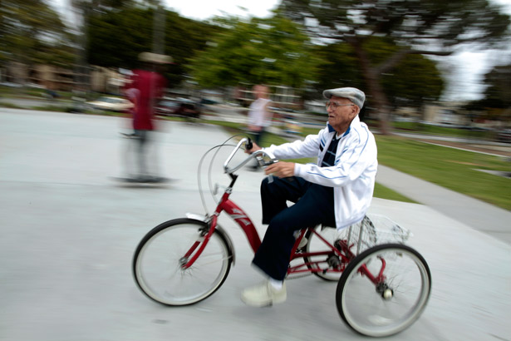
A centenarian riding his bike in Long Beach, California (Reuters).

Slide 3
Average American now lives 30 years longer
1900’s – just over 49 years
2010 – 78.5 years
Improved sanitation
Basic medicine
Vaccines
Surgical hygiene
Sterilization
Sanitation of the water supply
Pasteurization of milk
Personal hygiene

Slide 4
NO YES
disastrous social effects
stiffer competition for resources
a wider gap between rich and poor
the aging process is important because it gives death a kind of time release effect, which eases us into accepting it.

Slide 5
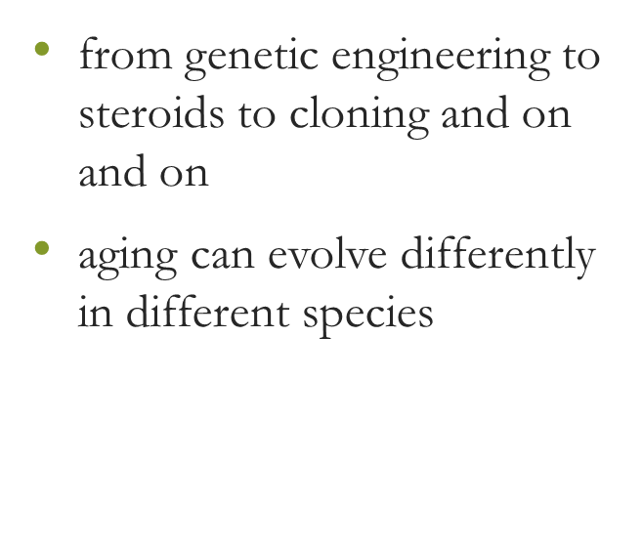
The argument from evolution
from genetic engineering to steroids to cloning and on and on
aging can evolve differently in different species

Slide 6
Lobster Human Being
American Lobster lives about as long as a human being
At the end of its life, its body doesn't show much in the way of weakening or wasting like you see in a human body of advanced age
Lobsters seem to have evolved an adaptation against the cellular lifespan

Slide 7
How?
the DNA in our cells basically unravel after they've divided a certain amount of times, but lobsters have this enzyme that helps them replenish their telomeres - the caps that hold DNA together
other species give off an antioxidant chemical in their bodies that prevent these oxidizing free radicals in our bodies from breaking us down

Slide 8
Arguments FOR
the aging process makes an elderly person's death less painful for the survivors around her, because it gradually forces people to stop relying on her, and forces her to gradually remove herself from society
it helps us to let go of somebody. And of course it's true that when people grow old, they become less useful to society, and more socially difficult, which places burdens on people. And in a lot of cases we respond to this by cutting them out of our lives, essentially. People get older, they move into a nursing home, and we see them less and less, and then when they finally die everyone's like, "well it was expected." Advanced age sort of helps us prepare emotionally for letting go of people, but it seems to me that it's not good for the person who gets old.

Slide 9
Arguments FOR

Slide 10
Arguments AGAINST

Slide 11
Arguments AGAINST

